Slide 1
REVIEW MODUL 11
- Array, Searching and Sorting -
Lab Dasar FIK - 2011

Slide 2
ARRAY
Array is a type which refers to one or group of elements using index
Type of array:
  2 Dimention
  3 Dimention

Slide 3
EXAMPLE :
int data [5] = {5, 7, 2, 6, 9}
data[0] -> 5 , data[1] -> 7, data[2] ->2,
data[3] -> 6, data[4] -> 9
<- data
<- index
5 | 7 | 2 | 6 | 9
0 | 1 | 2 | 3 | 4

Slide 4
String : array of char
example : ASIK ->
char tanggal[4][10] = {apel, pisang, jeruk, nangka}
tanggal[0] -> apel ; tanggal[1] -> pisang
tanggal[2] -> jeruk ; tanggal[3] -> nangka
A | S | I | K
0 | 1 | 2 | 3

Slide 5
SEARCH
Search is process of looking for a data from a group of data
Some searching techniques :
Binary Search
Sequential Search
Interpolasi Search

Slide 6
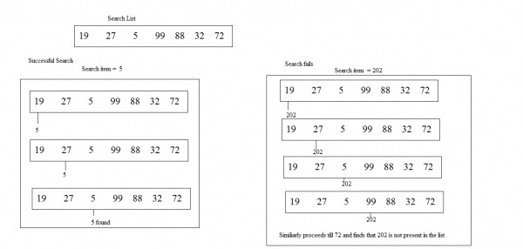
Sequential Search
Idea of Sequential Search is comparing the result of searching one by one.

Slide 7
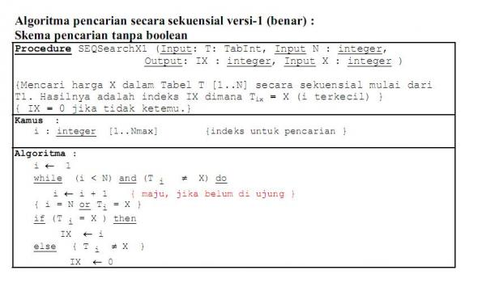
ALGORITMA

Slide 8
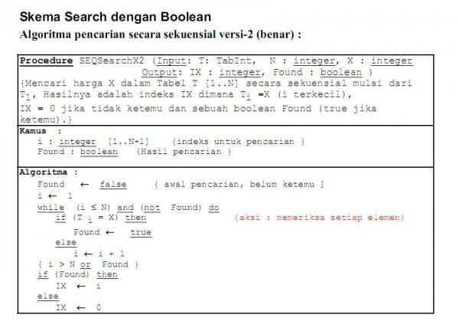
ALGORITMA

Slide 9
BINARY SEARCH
Searching performed by finding the result through a large or small comparison using a recursive

Slide 10
BINARY SEARCH FLOWCHART
BinarySearch (Key, A, LTH)
Locn = -1
Lo = 0
Hi = LTH - 1
While Hi > Lo
m = (Lo + Hi) / 2
Key = A[m]
Locn = m
Break
Key < A[m]
Hi = m-1
Lo = m+1
Return Locn
Binary Search

Slide 11
C/C++ BINARY SEARCH FCN
//--------------------------------------------
// Binary Search Algorithm:
// Divide the remaining table in half
// Check the midpoint; if found, DONE
// If not found, consider the first half
// or second half, depending...
// and do Binary Search on it
// If the partition size goes to ONE, the
// item is NOT present in the table
//--------------------------------------------
int BinarySearch (const int nKey,
const int nArray [],
const int nLth)
{
int nLoc = -1, nLow = 0, nHigh = nLth-1;
while (nHigh >= nLow) {
int m = (nLow + nHigh) / 2;
if (nKey == nArray [m])
{ nLoc = m; break; }
if (nKey < nArray [m])
nHigh = m - 1;
else
nLow = m + 1;
}
return nLoc;
}
Binary Search

Slide 12
SORTING
Sorting is data process to sort data.
Some technique of sorting are Bubble Sort, Count Sort, Selection Sort, Insertion Sort, dll

Slide 13
SORT
void Sort (int T[ ], int N){
int x; int pass; int temp;
for(pass=1;pass<=N-1;pass++){
for(x=pass+1;x<=N;x++){
if((T[pass])>(T[x])) {
temp= (T[x]);
(T[x]) = (T[pass]);
(T[pass]) = temp;
}
}
}
}

Slide 14
Initial Data
5 | 1
2 | 2
4 | 3
8 | 4
1 | 5

Slide 15
pass = 1
x = 2
5 | 1
2 | 2
4 | 3
8 | 4
1 | 5
T [ pass ] => T [ 1 ] = 5
T [ x ] => T [ 2 ] = 2
Is T [ pass ] > T [ x ] ?
Yes , 5 > 2
So, exchange….

Slide 16
pass = 1
x = 2
5 | 1
2 | 2
4 | 3
8 | 4
1 | 5
T [ x ] => T [ 2 ] = 2
T [ x – 1 ] => T [ 1 ] = 5
Is T [ x ] < T [ x – 1 ] ?
Yes , 2 < 5
So, exchange….

Slide 17
pass = 1
x = 2
2 | 1
5 | 2
4 | 3
8 | 4
1 | 5

Slide 18
pass = 1
x = 3
2 | 1
5 | 2
4 | 3
8 | 4
1 | 5
T [ pass ] => T [ 1 ] = 2
T [ x ] => T [ 3 ] = 4
Is T [ pass ] > T [ x ] ?
No , 2 !> 4
So changeless….

Slide 19
pass = 1
x = 4
2 | 1
5 | 2
4 | 3
8 | 4
1 | 5
T [ pass ] => T [ 1 ] = 2
T [ x ] => T [ 4 ] = 8
Is T [ pass ] > T [ x ] ?
No , 2 !> 8
So changeless….

Slide 20
pass = 1
x = 5
2 | 1
5 | 2
4 | 3
8 | 4
1 | 5
T [ pass ] => T [ 1 ] = 2
T [ x ] => T [ 5 ] = 1
Is T [ pass ] > T [ x ] ?
Yes , 2 > 1
So, exchange….

Slide 21
pass = 1
x = 5
2 | 1
5 | 2
4 | 3
8 | 4
1 | 5
T [ pass ] => T [ 1 ] = 2
T [ x ] => T [ 5 ] = 1
Is T [ pass ] > T [ x ] ?
Yes , 2 > 1
So, exchange….

Slide 22
pass = 1
x = 5
1 | 1
5 | 2
4 | 3
8 | 4
2 | 5

Slide 23
pass = 2
x = 3
1 | 1
5 | 2
4 | 3
8 | 4
2 | 5
T [ pass ] => T [ 2 ] = 5
T [ x ] => T [ 3 ] = 4
Is T [ pass ] > T [ x ] ?
Yes , 5 > 4
So, exchange….

Slide 24
pass = 2
x = 3
1 | 1
5 | 2
4 | 3
8 | 4
2 | 5
T [ pass ] => T [ 2 ] = 5
T [ x ] => T [ 3 ] = 4
Is T [ pass ] > T [ x ] ?
Yes , 5 > 4
So, exchange….

Slide 25
pass = 2
x = 3
1 | 1
4 | 2
5 | 3
8 | 4
2 | 5

Slide 26
pass = 2
x = 4
1 | 1
4 | 2
5 | 3
8 | 4
2 | 5
T [ pass ] => T [ 2 ] = 4
T [ x ] => T [ 4 ] = 8
Is T [ pass ] > T [ x ] ?
Yes , 4 !> 8
So, changeless….

Slide 27
pass = 2
x = 5
1 | 1
4 | 2
5 | 3
8 | 4
2 | 5
T [ pass ] => T [ 2 ] = 4
T [ x ] => T [ 5 ] = 2
Is T [ pass ] > T [ x ] ?
Yes , 4 > 2
So, exchange….

Slide 28
pass = 2
x = 5
1 | 1
4 | 2
5 | 3
8 | 4
2 | 5
T [ pass ] => T [ 2 ] = 4
T [ x ] => T [ 5 ] = 2
Is T [ pass ] > T [ x ] ?
Yes , 4 > 2
So, exchange….

Slide 29
pass = 2
x = 5
1 | 1
2 | 2
5 | 3
8 | 4
4 | 5

Slide 30
pass = 3
x = 4
1 | 1
2 | 2
5 | 3
8 | 4
4 | 5
T [ pass ] => T [ 3 ] = 5
T [ x ] => T [ 4 ] = 8
Is T [ pass ] > T [ x ] ?
Yes , 5 !> 8
So, changeless….

Slide 31
pass = 3
x = 5
1 | 1
2 | 2
5 | 3
8 | 4
4 | 5
T [ pass ] => T [ 3 ] = 5
T [ x ] => T [ 5 ] = 4
Is T [ pass ] > T [ x ] ?
Yes , 5 > 4
So, exchange….

Slide 32
pass = 3
x = 5
1 | 1
2 | 2
5 | 3
8 | 4
4 | 5
T [ pass ] => T [ 3 ] = 5
T [ x ] => T [ 5 ] = 4
Is T [ pass ] > T [ x ] ?
Yes , 5 > 4
So, exchange….

Slide 33
pass = 3
x = 5
1 | 1
2 | 2
4 | 3
8 | 4
5 | 5

Slide 34
pass = 4
x = 5
1 | 1
2 | 2
4 | 3
8 | 4
5 | 5
T [ pass ] => T [ 4 ] = 8
T [ x ] => T [ 5 ] = 5
Is T [ pass ] > T [ x ] ?
Yes , 8 > 5
So, exchange….

Slide 35
pass = 4
x = 5
1 | 1
2 | 2
4 | 3
8 | 4
5 | 5
T [ pass ] => T [ 4 ] = 8
T [ x ] => T [ 5 ] = 5
Ia T [ pass ] > T [ x ] ?
Yes , 8 > 5
So, exchange….

Slide 36
pass = 4
x = 5
1 | 1
2 | 2
4 | 3
5 | 4
8 | 5

Slide 37
Result of sorted data
1 | 1
2 | 2
4 | 3
5 | 4
8 | 5

Slide 38
Thank You
Have a nice try..
Any Question?

